Slide 1


CE141: COMPUTER CONCEPTS & PROGRAMMING
July – November 2018
Chapter - 8
Conditional Statements & Branching
Devang Patel Institute of Advance Technology and Research

Slide 2
Objectives
To get understanding of decision making in ‘C’ Language.
To develop programming skills using different types of if Conditions.
To impart the knowledge switch statement in C.
To understand use of if…else instead of conditional operator.

Slide 3


Slide 4
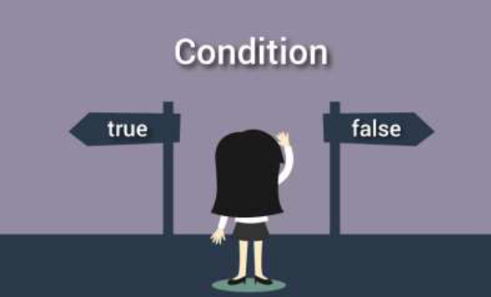
Decision making in C
“Decision making and branching” is one of the most important concepts of computer programming.
Programs should be able to make logical (true/false) decisions based on the condition provided.
Every program has one or few problems to solve. In order to solve those particular problems important decisions have to be made depending on the nature of the problems.
So controlling the execution of statements based on certain condition or decision is called decision making and branching.

Slide 5
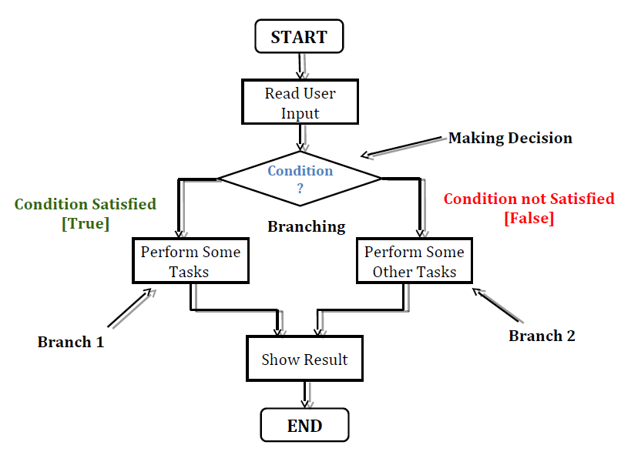
Decision making in C

Slide 6
Holiday trip Problem
Consider the fact that you and some of your friends have planed to go out for a holiday trip after the Semester.
You have also decided that if you have got received money 10000 Rupees or more from your parent then you will go out for a foreign trip.
Otherwise, if the allotted money is less than 10000 then you will go out for a country side trip.
Now you are supposed to design a program to solve this problem.

Slide 7
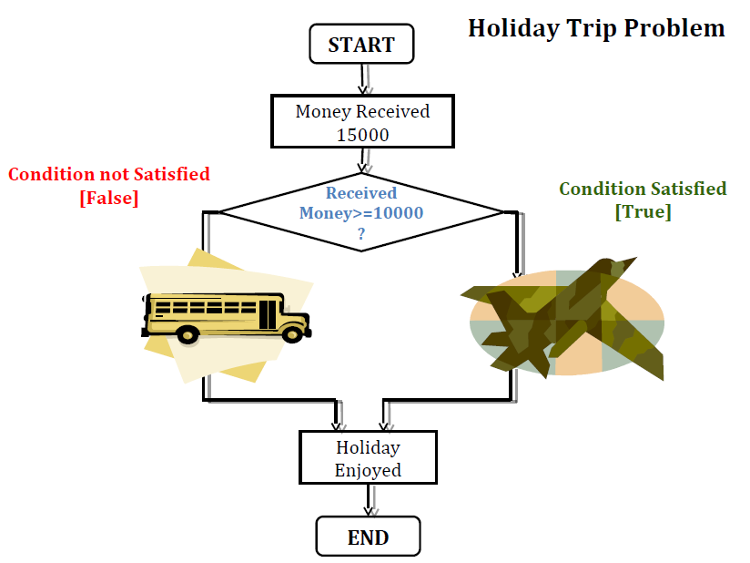

Slide 8
Decision making in C
C language possesses decision making and branching capabilities by supporting the following statements:
  If statement
  Switch statement
  Conditional operator statement
  goto statement
These statements are knows as decision making statements.
They are also called control statements as the control the flow of execution.

Slide 9
Decision making using if
The if statement is a powerful statement for decision making and is used to control the flow of execution of statements.
It is basically a two-way decision making statement and is used in conjunction with an expression.
It takes the following structure:
if (test-condition)
It allows the computer to evaluate the expression first and then depending on whether the value of the expression or condition is true or false, it transfer the control to a particular statement.
This point of program has two paths to follow, one for the true condition and the other for the false condition.

Slide 10
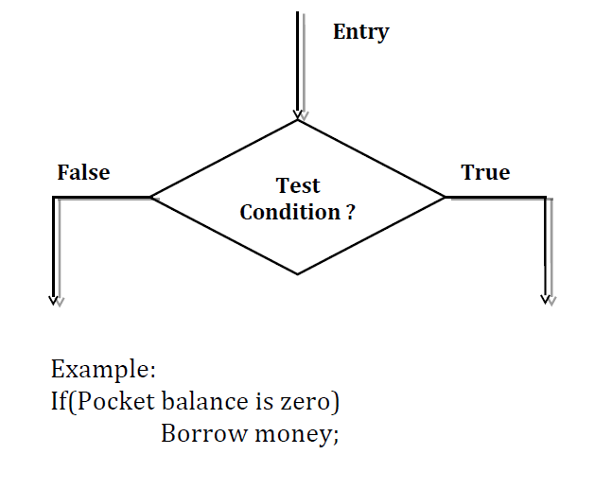
Decision making using if

Slide 11
Decision making using if
The if statement can be implemented if four different forms depending on the complexity of the conditions to be tested.
The four forms are:
  Simple if statement
  If else statement
  Nested if else statement
  Else if ladder

Slide 12
Simple if statement
The general form of a simple if statement is:
    if (test_condition)
    {
    statement-block;
    }
    statement x;

Slide 13
Simple if statement
The general form of a simple if statement is:
The statement block may consists of a single statement or a group of statements.
If the test_condition is satisfied then the statement block will be executed first then the statement-x will be executed after completing the execution of statement block.
Otherwise if the test_condition doesn’t satisfied then, the statement block will be skipped and the execution will jump to the statement-x.
So in short when the condition is true then both the statement block and the statement-x are executed but in sequence.

Slide 14
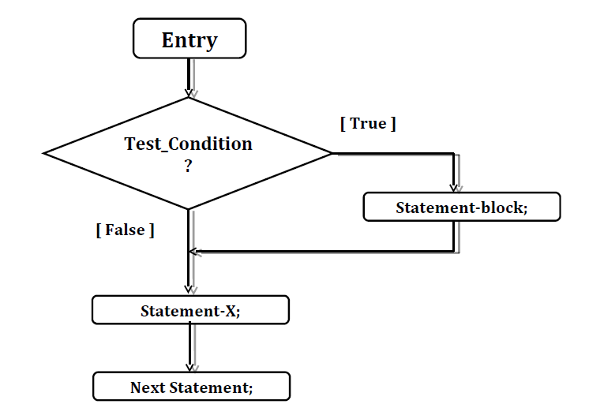
Simple if statement - Flowchart

Slide 15
Simple if statement - Example
#include<stdio.h>
void main()
{
int number = 0;
printf("\nEnter an integer between 1 and 10: ");
scanf("%d",&number);
if (number > 7)
printf("You entered %d which is greater than 7\n", number);
if (number < 3)
printf("You entered %d which is less than 3\n", number);
}

Slide 16
if…else statement
If…else is an extension of the simple if statement.
If the test condition is true then the true block statements, immediately following the if statements are executed.
Otherwise the false block statements are executed.
In short either true-block or false-block of statements will be executed, not both.
But in both cases the control is transferred subsequently to the statement-x as it is an independent (not controlled by the if else statement) statement.
It is also called two way conditional branching.

Slide 17
if…else statement - Structure
The if else statement is an extension of the simple if statement.
The general form is :
    if (test_condition)
    {
    True block statements;
    }
    else
    {
    False block statements;
    }
    statement-x;

Slide 18
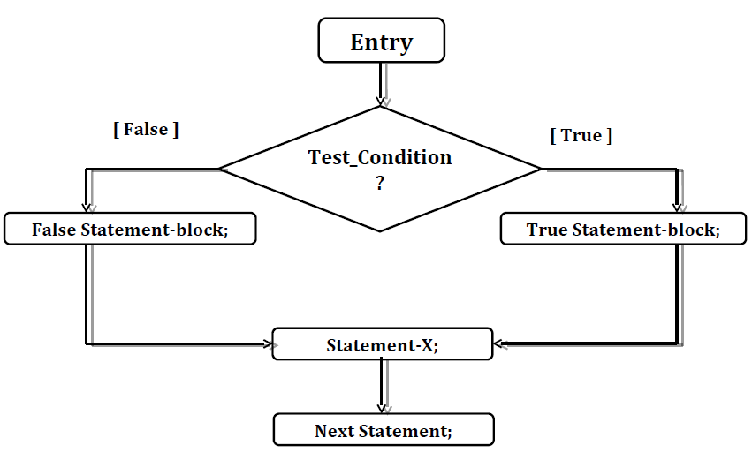
if…else statement- Flowchart

Slide 19
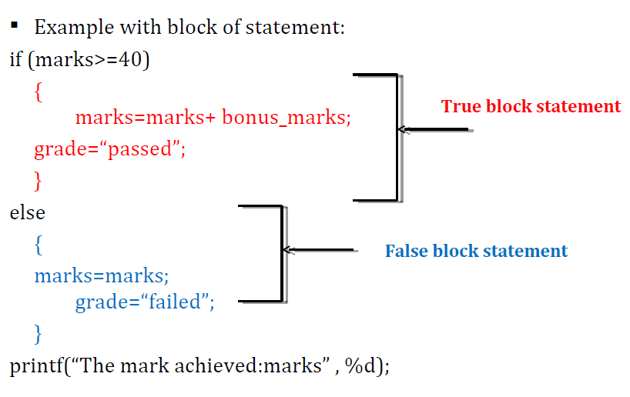
if…else statement- Example

Slide 20
Nesting of if…else
If the series of decisions are involved, we may have to use more than one if…else statement in nested form.
Using “if…else statement” within another “if…else statement” is called ‘nested if statement’.
“Nested if statements” is mainly used to test multiple conditions.
It is called nested conditional branching.

Slide 21
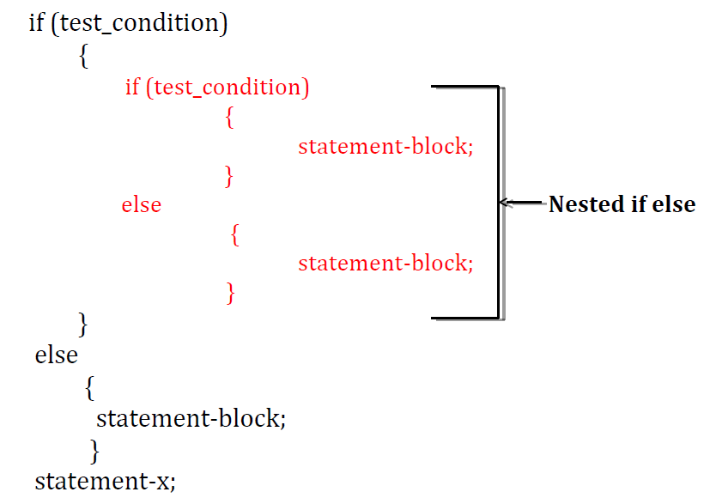
Nesting of if…else - Structure

Slide 22
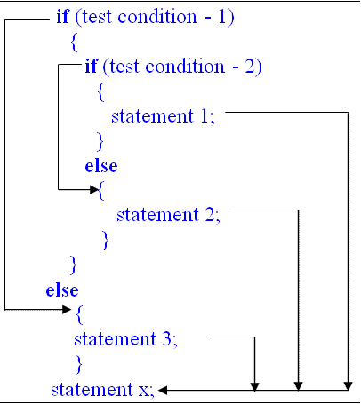
Nesting of if…else – Execution Flow

Slide 23
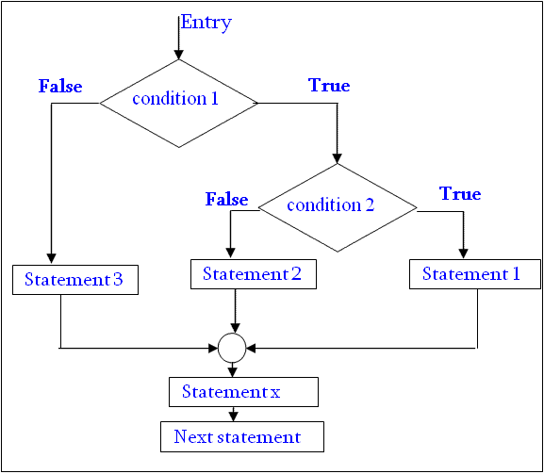
Nesting of if…else - Flowchart

Slide 24
Nesting of if…else - Example
if (gender==female)
{
  if (age<10)
  {
    provide free entry;
    provide free food;
  }
  else
  {
    provide only free entry;
  }
}
else
{
statement-block;
}
statement-x;
Nested if else

Slide 25
else…if Ladder
The word ladder means the staircase.
As the name implies this statement is used to choose right way/paths among multiple paths.
There is another way of putting if conditions together when multiway decisions are involved.
A multiway decision is a chain of if conditions in which the statement associated with an else condition behaves like another if condition.
Else if ladder is also called 3 way or multiway decision making statement.

Slide 26
else…if Ladder - Structure
if (test_condition 1)
statement-1;
else if (test_condition 2)
statement-2;
else if (test_condition 3)
statement-3;
else if (test_condition 4)
statement-4;
…………………………………..
else if (test_condition n)
statement-n;
statement-x;

Slide 27
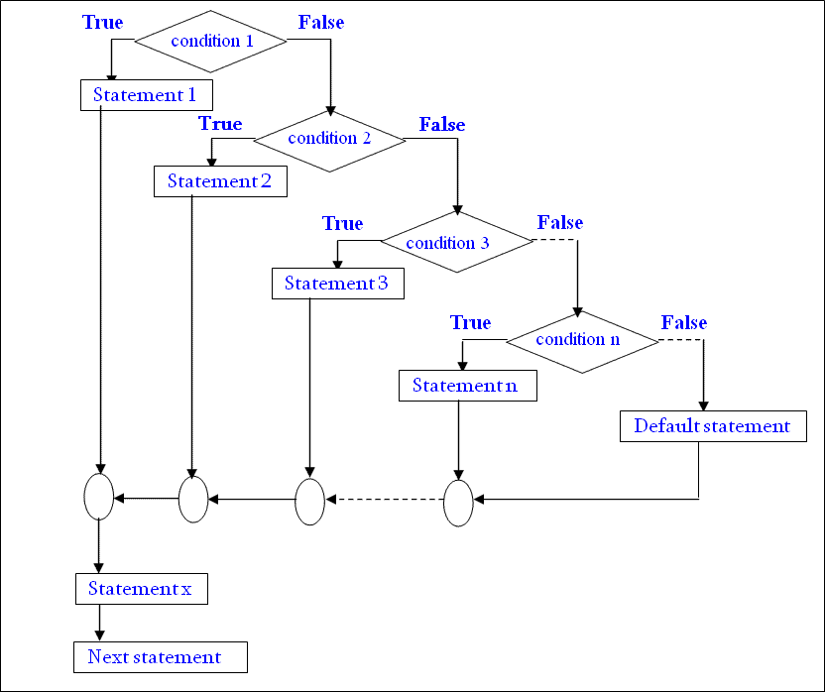
else…if Ladder - Flowchart

Slide 28
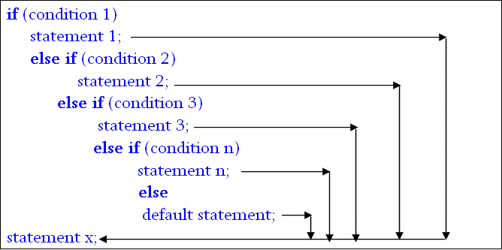
else…if Ladder – Execution Flow

Slide 29
else…if Ladder - Example
if(mark>=50 && mark<60)
{
printf("Your grade is D");
}
else if(mark>=60 && mark<70)
{
printf("Your grade is C n");
}
else if(mark>=70 && mark<80)
{
printf("Your grade is B n");
}
else if(mark>=80 && mark<90)
{
printf("Your grade is A n");
}
else
printf("you have failed");

Slide 30
Switch Statement
When one of the many statements is to be selected, then if conditional statement can be used to control the selection.
However the complexity of such a program increases dramatically when the number of statements increases.
Fortunately, C has a built in multiway decision making statement known as switch.
The switch statement tests the value of a given variable or expression against a list of case values and when a match is found only then a block of statements associated with that case is executed.

Slide 31

Switch - Structure
switch(expression/ value)
{
  case value-1:
      statement-block-1;
      break;
  case value-2:
      statement-block-2;
      break;
      ……………………….
  case value-n:
      statement-block-n;
      break;
  default:
  default-statement-block;
  break;
}
statement-x;

Slide 32
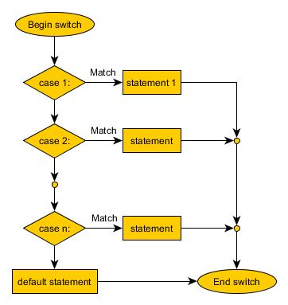
Switch - Flowchart

Slide 33
Switch - Example
switch(choice)
{
case 1:
printf("Enter 2 numbers");
scanf("%d%d", &a, &b);
c = a + b;
printf("%d", c);
break;
case 2:
printf("Enter 2 numbers");
scanf("%d%d", &a, &b);
c = a - b;
printf("%d", c);
break;
default:
printf(“wrong key");
printf("\npress any key to continue" );
}
}
}
#include<stdio.h>
void main( )
{
int a, b, c, choice;
while(choice != 3)
{
/* Printing the available options */
printf("\n 1. Press 1 for addition");
printf("\n 2. Press 2 for subtraction");
printf("\n Enter your choice");
/* Taking users input */
scanf("%d", &choice);

Slide 34
Rules for Switch Statement
The switch statement must be an integral type.
Case labels must be constant or constant expression.
Case labels must be unique. No two labels can have the same value.
Case labels must end with colon.
The break statement transfer the control out of the switch statement.
The break statement is optional. So two or more case labels may belong to the same statements.
The default label is optional. If present, it will be executed when the expression does not find a matching case label.
There can be at most one default label.
The default may be placed any where but usually placed at the end.
It is permitted to nest switch statements.

Slide 35
Conditional Operator
The C language has an unusual operator which is useful for making two way decisions.
This operator is a combination of ? and :
It takes three operands. This operator is popularly known as the conditional operator.
The conditional operator can be used as the replacement of if else conditional statement for two way decision making.

Slide 36
Conditional Operator
The general structure of conditional operator:
Conditional expression? true-statement 1: false-statement;
The condition is evaluated first. If the result is true then the statement 1 is executed and its value is returned.
Otherwise statement 2 is executed and its value is returned.
Example:
flag = (x<0) ? 0 :1;

Slide 37
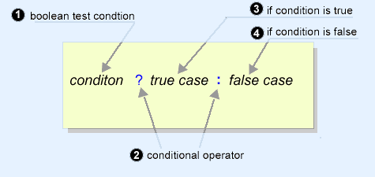
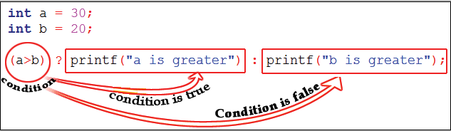
Conditional Operator - Execution

Slide 38
Use of if…else instead of conditional operator
Conditional operator:
      flag = (x<0) ? 0 :1;
It is equivalent to:
      if(x<0)
      flag=0;
      else
      flag=1;

Slide 39

goto statement
A goto statement in C programming provides an unconditional jump from the 'goto' to a labeled statement in the same function.
Syntax1 | Syntax2
----------------------------
goto label; | label:
. | .
. | .
. | .
label: | goto label;

Slide 40

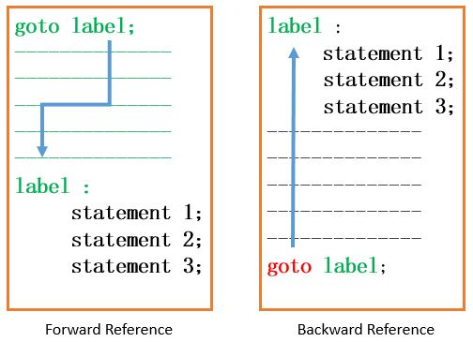
goto statement

Slide 41
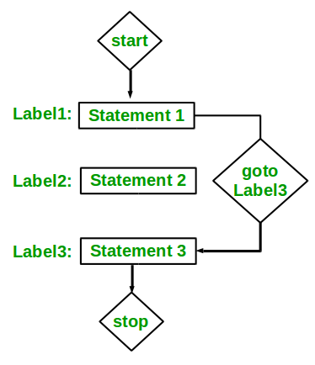
goto statement - Example
#include <stdio.h>
int main()
{
int sum=0;
for(int i = 0; i<=10; i++)
  {
  sum = sum+i;
  if(i==5)
  {
  goto addition;
  }
  }
  addition:
  printf("%d", sum);
  return 0;
  }

Slide 42
Disadvantages of using goto statement
The use of goto statement is highly discouraged as it makes the program logic very complex.
Use of goto makes really hard to modify the program.
Use of goto can be simply avoided using break and continue statements.

Slide 43
Previous Year Questions
Which are the keywords in switch statement?
Differentiate: nesting of if vs else….if ladder statements.
Write a program to make simple calculator using arithmetic operators as a input using switch…case.
Explain else..if ladder with example.
Write a program to implement user iterative calculator. The program allows four operation +,-,*,/. For / operation, also print an error if division is not possible.
Explain nested if and switch statement with Example.
Replace code using if…else statement.
que = (q1>q2)?((q1>q3)?q1:q3):q2;

Slide 44


